Slide 1





Track: SIH Logistics & Supply Chain (Software)
QUANTAFLEET
CORE PROVEN METRIC
11.2%
Quantum-Inspired Fleet Routing for Smarter Logistics
MAX DISTANCE REDUCTION
Validated against classical baselines in tested scenarios
Drastically reducing fleet travel distance • Fuel consumption • Dispatch cost through advanced QUBO formulation.
Experience the innovation at : https://quantafleet.onrender.com/
TEAM CREDENTIALS
Team Q-bits 26
PROBLEM STATEMENT REFERENCE
Logistics Software Innovation
PS ID: SIH1624 — Automated Enterprise Fleet Optimization & Route Planning

Slide 2






Why Enterprise Fleet Routing Fails
Main Question: Why is enterprise fleet routing still severely inefficient despite current software tools?
Combinatorial Explosion
Routing Mechanic Comparison
As delivery stops and vehicles scale, candidate route permutations grow exponentially, overwhelming traditional algorithmic software tools.
GREEDY ROUTING (Classical Standard)
Local Rules Trapped in Bad Routes
Greedy "nearest-neighbor" heuristics pick close stops first, trapping trucks down dead ends or coastal corridors—forcing 25km+ backtracks.
High mileage • Wasted fuel • Myopic local choices
QUANTAFLEET (Quantum-Inspired)
Real Roads ≠ Straight Lines
Naive routing ignores true network topology—such as one-way street constraints, bridge bottlenecks, and turn restrictions.
Global energy minimum • Zero backtrack • Topology aware

Slide 3



Our Solution: QuantaFleet
Fleet Data
OSMNX Road Graph
Constraint Engine
QUBO Solver
Optimized Routes
1. Real Road Geometry
2. Multiple Vehicle CVRP
Integrates full OSMNX real-world road graph geometry instead of Euclidean straight lines, ensuring exact road distance matrices.
Full Capacity-Constrained Vehicle Routing Problem (CVRP) execution to manage vehicle limits, stop priorities, and depot constraints.
3. Global QUBO Optimization
4. Explainable Dispatch Output
QUBO-based mathematical search exploring global combination spaces simultaneously to completely bypass local myopic traps.
Interactive route polylines with turn-by-turn sequence badges (①, ②, ③…) and clear export metrics for dispatchers.

Slide 4
System Architecture
STAGE 01
User / Fleet Operator Interface $\longrightarrow$ React + Leaflet Web UI
Input Layer
Allows stop placement, depot config, capacity specs, & vehicle count settings.
STAGE 02
FastAPI REST Service $\longrightarrow$ Scenario & OSMNX Road Graph Mapper
Processing Layer
Extracts real shortest paths, distance matrices, and network edge constraints.
STAGE 03
CVRP Constraint Formulation $\longrightarrow$ QUBO Optimization Engine
Optimization Layer
Translates business constraints into Quadratic Unconstrained Binary Optimization matrices.
STAGE 04
Optimized Polyline Routes $\longrightarrow$ Dashboard Map + Export Metrics
Output Layer
Provides turn-by-turn sequence badges, driver route exports, & distance analytics.

Slide 5


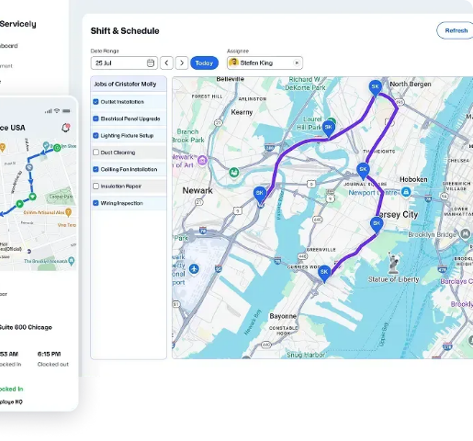



Live Prototype & Measured Results
SCENARIO SPECS
•
INPUT: 80 Delivery Points • 10 Vehicles • Strict Capacity Limits
•
ENGINE: OSMNX Road Network • QUBO Matrix • 400 Annealing Reads
•
OUTPUT: Interactive Polyline • Load Distribution • Export Dispatch
MEASURED HACKATHON BASE SCENARIO RESULT
Classical Baseline
QuantaFleet Output
267.25 km
249.19 km
Net Distance Saved:
18.06 km (6.8% Reduction)

Slide 6

The Innovation: QUBO Formulation
Routing Problem
Binary Variables
QUBO Matrix
Energy Minimization
Feasible Route
Plain English Logic
Hard Constraints Enforced
Fleet decisions are encoded as binary variables ($x_{i,j} \in \{0,1\}$). Penalty terms ($H_{\text{penalty}}$) mathematically eliminate illegal routes (e.g., missed stops or overloaded vehicles), while cost terms ($H_{\text{cost}}$) drive the optimizer toward global minimal road distance.
•
Single Visit: Every delivery stop visited exactly once
•
Capacity Limits: Vehicle load limits strictly enforced
•
Route Continuity: Sub-tour elimination and flow conservation
Deployment Readiness:

Slide 7




Technical Implementation
Frontend Dashboard
Asynchronous Backend
Interactive fleet dashboard built with React & Leaflet mapping.
High-performance REST API developed in Python FastAPI.
Provides real-time interactive polyline rendering and sequence step badges.
Handles scenario state management, matrix parsing, and solver calls asynchronously.
Road Graph Intelligence
Optimization Engine
Real-world graph routing built using OSMNX & NetworkX.
Binary Quadratic Models using dimod & Simulated Quantum Annealing.
Computes true shortest-path distance matrices taking turn restrictions into account.
Solves complex QUBO matrices on CPU (neal) with 400+ annealing reads per run.
DEPLOYMENT PHASING
Current Phase: CPU Software Simulation $\longrightarrow$ Next Phase: Direct Cloud QPU Execution

Slide 8



Measured Performance Benchmarks
Scenario Scale | Fleet (V) | Stops (N) | Classical Baseline | QuantaFleet | Distance Saved | Improvement
Light | 4 | 20 | 68.45 km | 66.53 km | -1.92 km | 2.8%
Medium | 5 | 40 | 142.80 km | 135.20 km | -7.60 km | 5.3%
Hackathon Base | 10 | 80 | 267.25 km | 249.19 km | -18.06 km | 6.8%
Dense Hub | 5 | 80 | 385.40 km | 346.86 km | -38.54 km | 10.0%
Enterprise Dense | 10 | 150 | 620.80 km | 551.27 km | -69.53 km | 11.2%
Methodology Note
Tested using real-world OSMNX road graph geometry comparing classical greedy dispatch heuristics against QUBO simulated annealing.
KEY OBSERVATION
Optimization gains scale higher as stop density and vehicle scaling increase (up to 11.2%).

Slide 9



Illustrative Enterprise Impact
Scenario Frame:
ANNUAL COST SAVINGS
DAILY FUEL SAVED
CARBON FOOTPRINT OFFSET
₹96.79 Cr
25,500 L
24,944 T
Projected annual fuel & vehicle maintenance reduction
Estimated reduction in daily diesel consumption
Annual $CO_2$ emissions offset achieved
Disclaimer: Illustrative projection based on standard fleet operating parameters and measured simulation distance improvements; not a verified enterprise site deployment result.

Slide 10


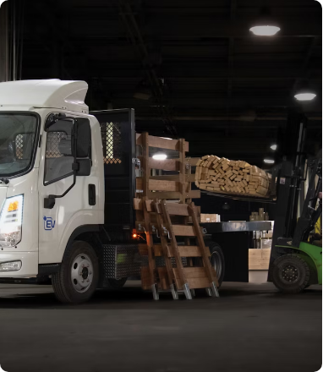


Scalable Enterprise Use Cases
Last-Mile Delivery
Focus: High-density urban parcel routes. Primary Metric: Minimal distance per delivered parcel.
Electric Vehicle (EV) Fleets
Focus: Range-constrained routing with integrated charging station nodes. Primary Metric: Energy consumption per route.
Cold-Chain Logistics
Focus: Time-window constrained perishable transport. Primary Metric: On-time delivery compliance.

Slide 11








Production Roadmap
PHASE 01
PHASE 02
PHASE 03
PHASE 04
NOW (MVP)
NEXT (QPU)
THEN (Hybrid)
SCALE (API)
•
CPU simulated annealing
•
D-Wave Leap cloud integration
•
Clustering + QUBO pipeline
•
Multi-depot fleet scaling
•
OSMNX road graph
•
Quantum hardware benchmarks
•
Dynamic recalculation on live traffic
•
Live telematics integration
•
Interactive React web UI

Slide 12


Why QuantaFleet Wins
Feature / Dimension | Standard Routing Tools | Classical Heuristics | QuantaFleet Engine
Optimization Focus | Point-to-point routing | Local search heuristics | Fleet-wide energy optimization
Road Mapping | Straight-line / simplified | Basic network graphs | Full OSMNX road network
Search Mechanics | Myopic local choices | Trapped in local minima | Global QUBO space search
Constraint Engine | Basic distance | Capacity limits | Capacity + Multi-constraint QUBO
Future Hardware | Classical only | Classical only | Native Quantum-Annealer Compatible
Key Takeaway: Up to 11.2% lower travel distance across enterprise scenarios.
Built as a functional MVP • Validated against classical baselines • Engineered to scale.

